Slide 1
Chapter 4: Threads & Concurrency

Slide 2
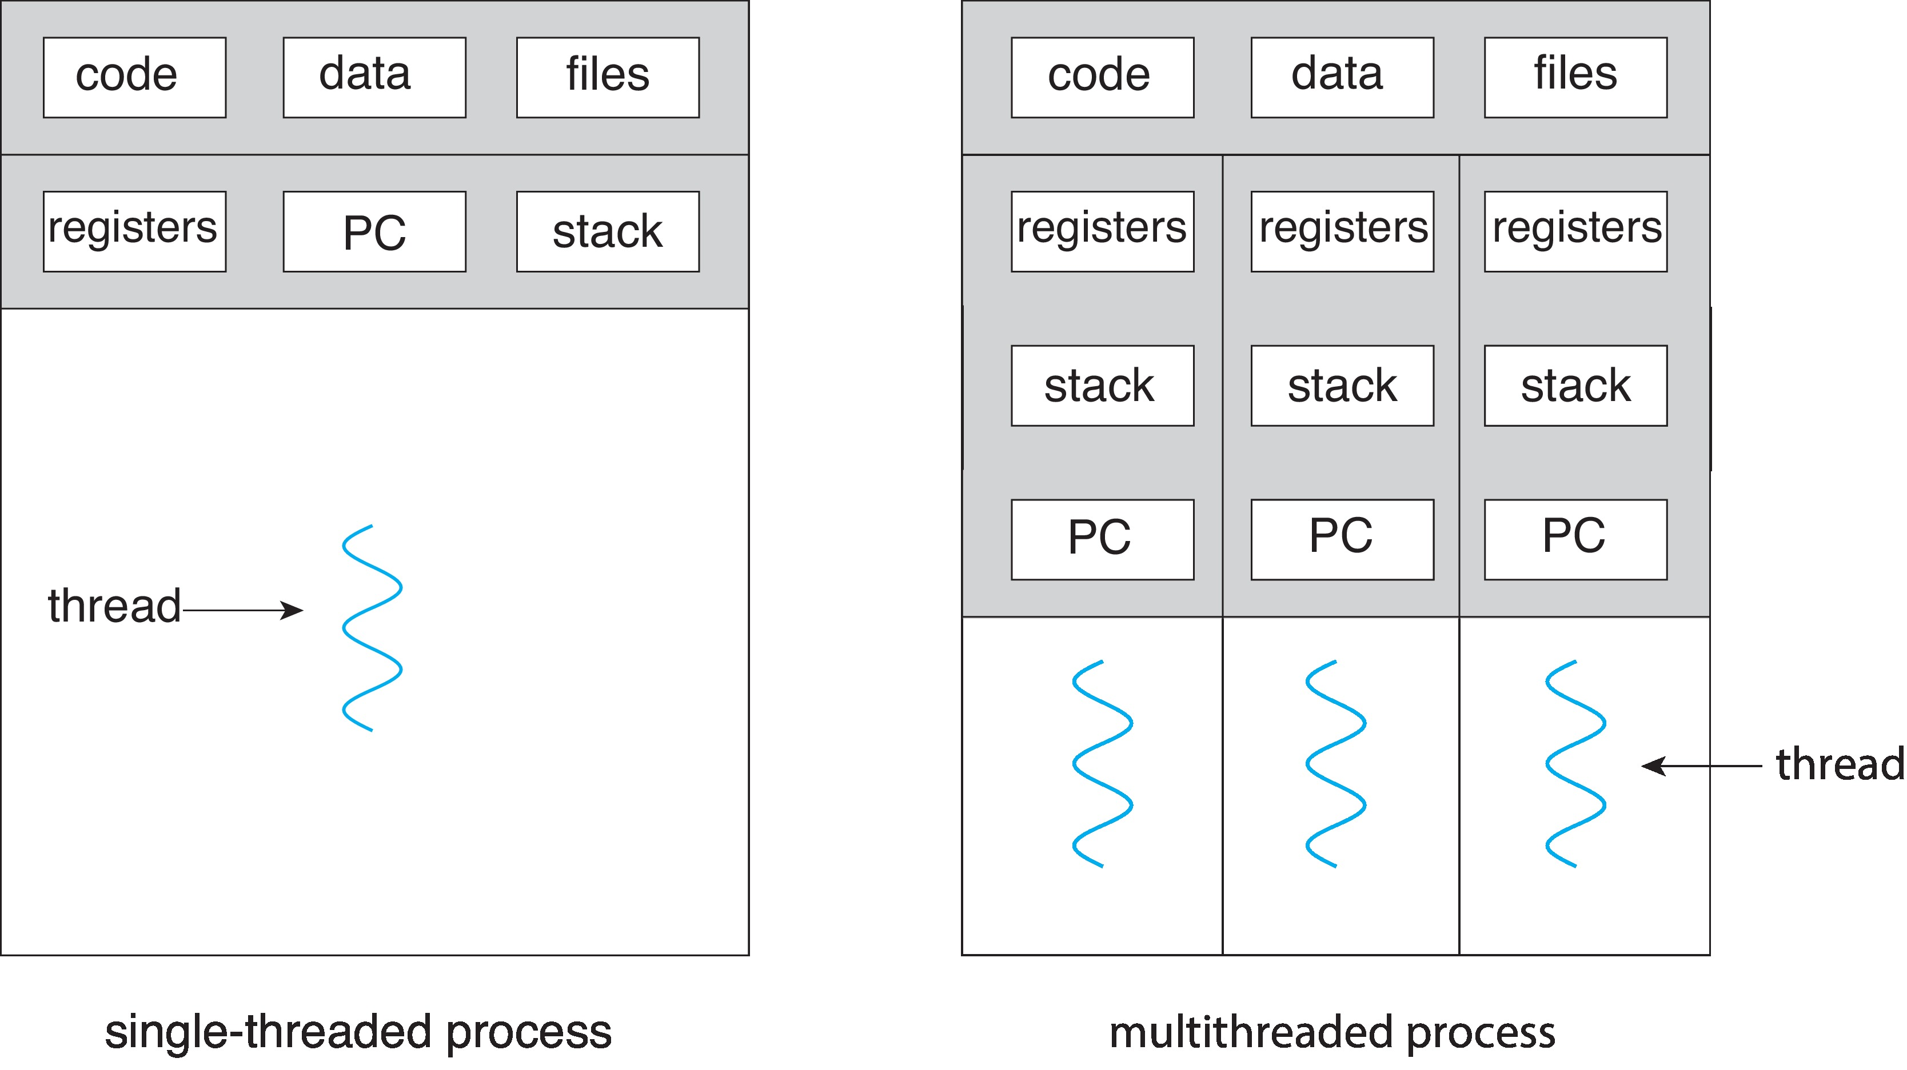
Single and Multithreaded Processes

Slide 3
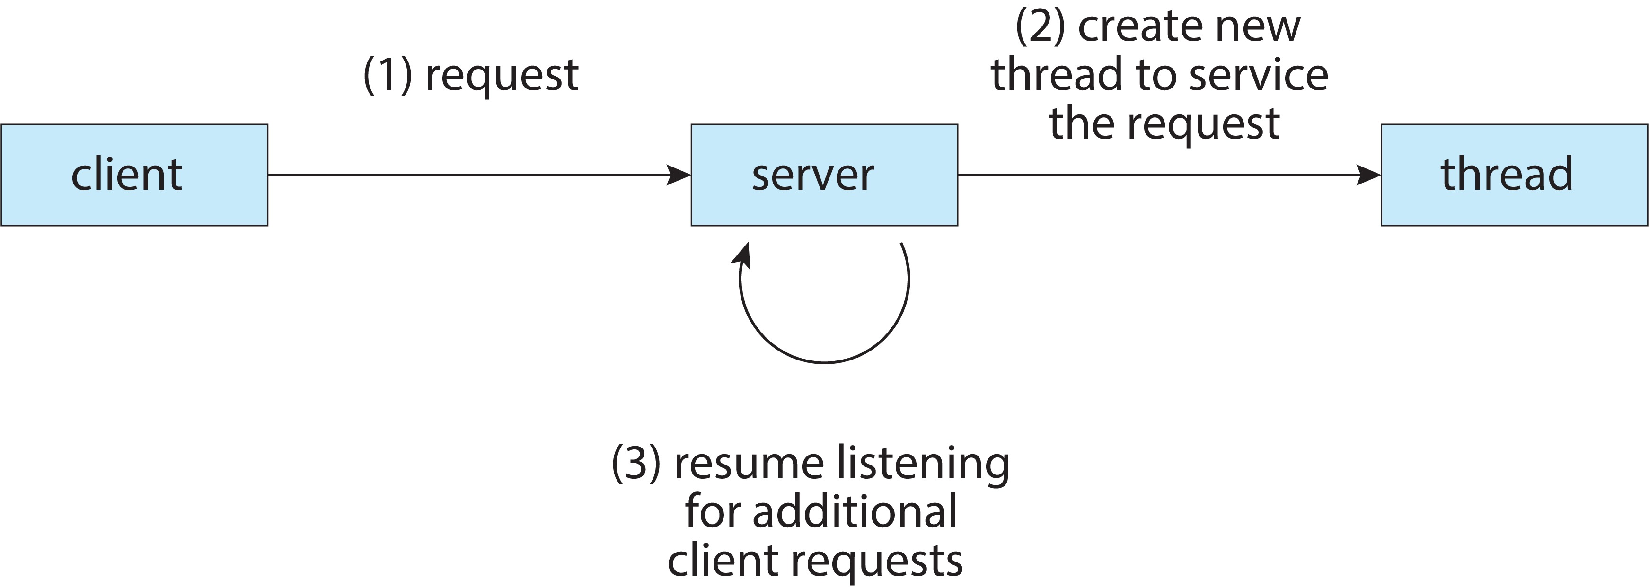
Multithreaded Server Architecture

Slide 4
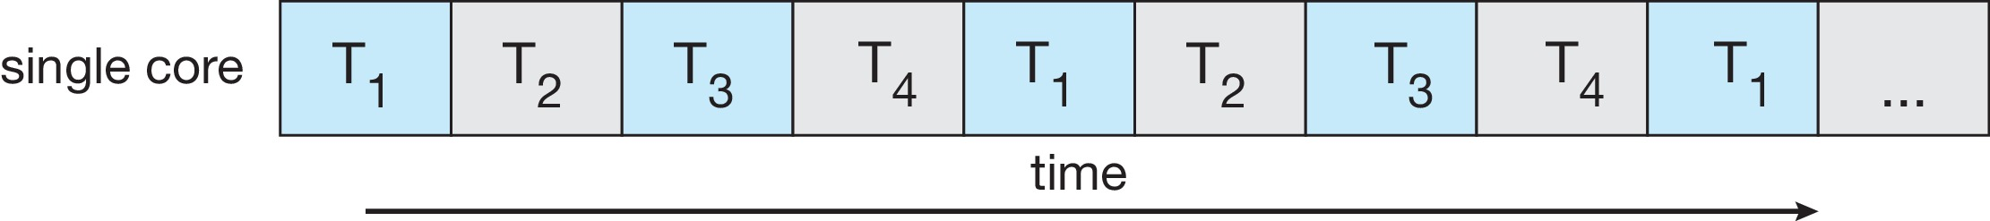
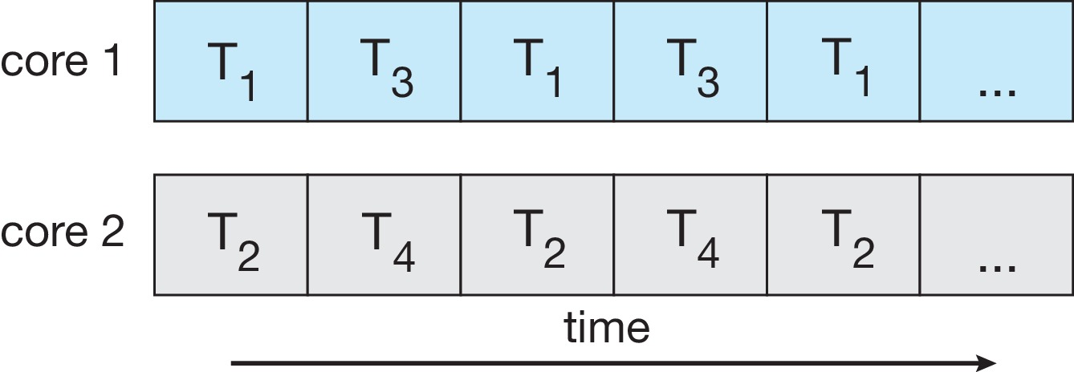
Concurrency vs. Parallelism
Concurrent execution on single-core system:
Parallelism on a multi-core system:

Slide 5
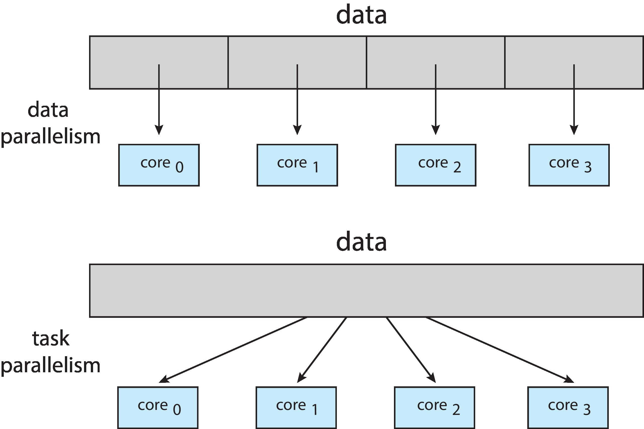
Data and Task Parallelism

Slide 6
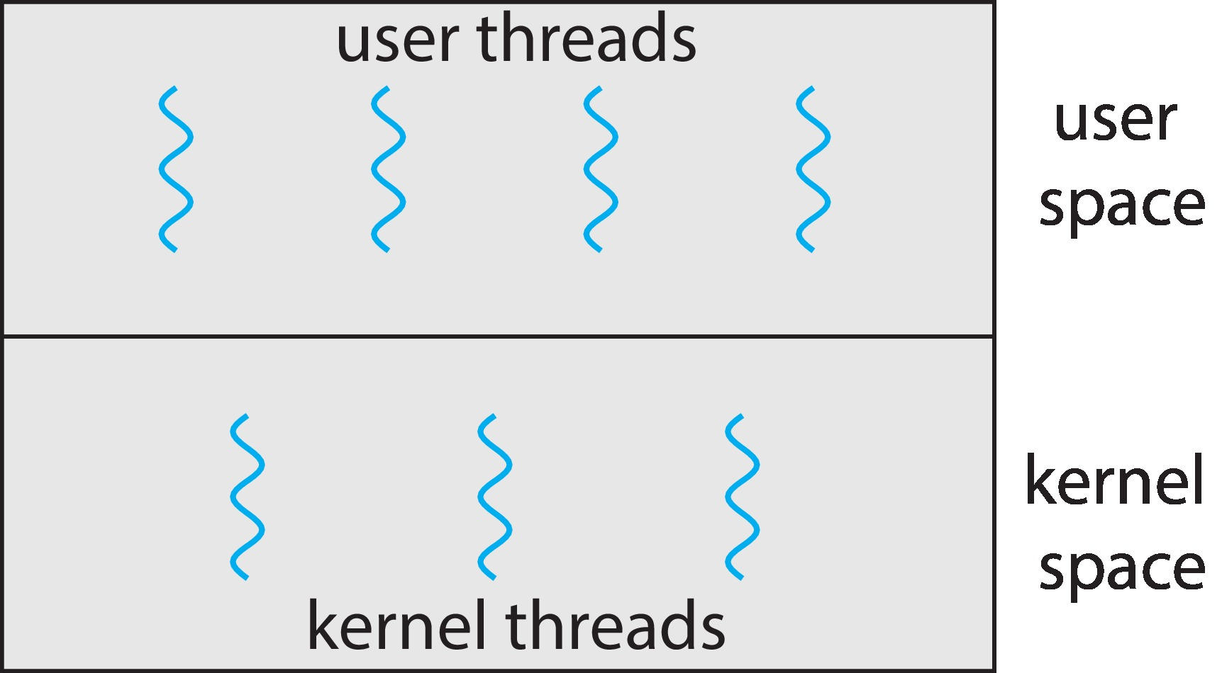
User and Kernel Threads

Slide 7
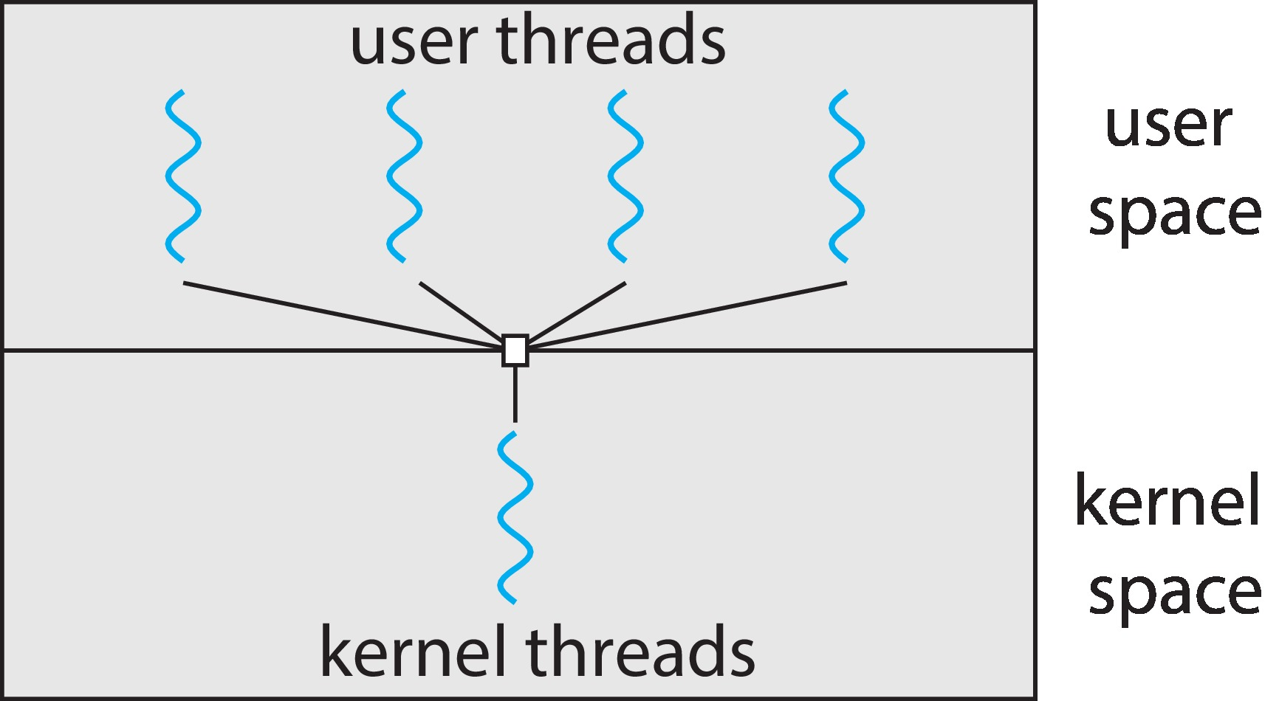
Many-to-One
Many user-level threads mapped to single kernel thread
One thread blocking causes all to block
Multiple threads may not run in parallel on muticore system because only one may be in kernel at a time
Few systems currently use this model
Examples:
Solaris Green Threads
GNU Portable Threads

Slide 8
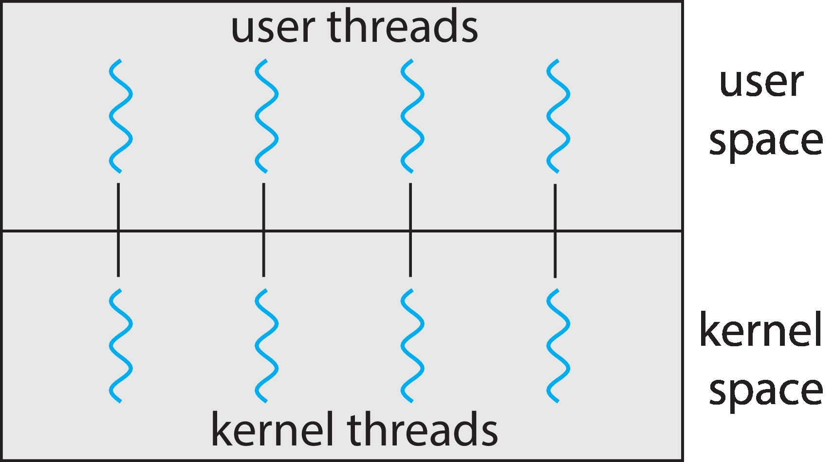
One-to-One
Each user-level thread maps to kernel thread
Creating a user-level thread creates a kernel thread
More concurrency than many-to-one
Number of threads per process sometimes restricted due to overhead
Examples
Windows
Linux

Slide 9
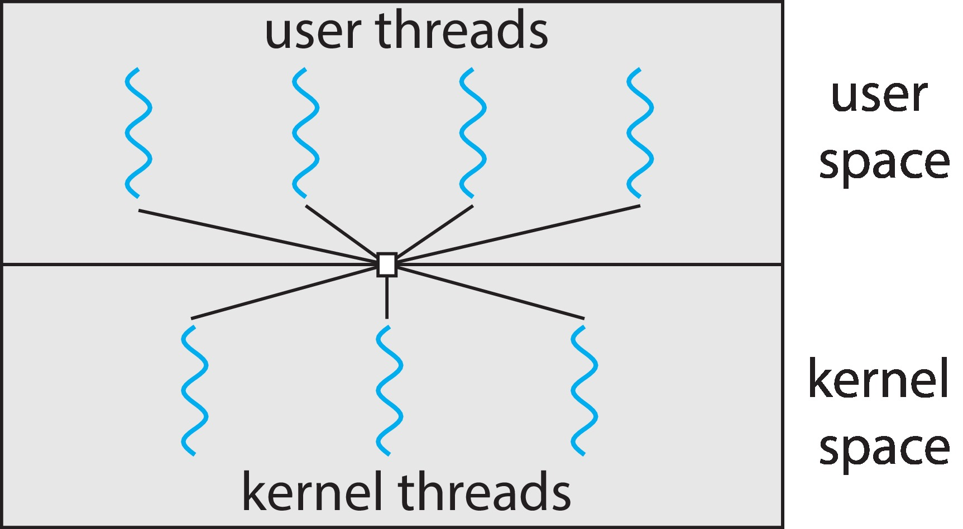
Many-to-Many Model
Allows many user level threads to be mapped to many kernel threads
Allows the operating system to create a sufficient number of kernel threads
Windows with the ThreadFiber package
Otherwise not very common

Slide 10
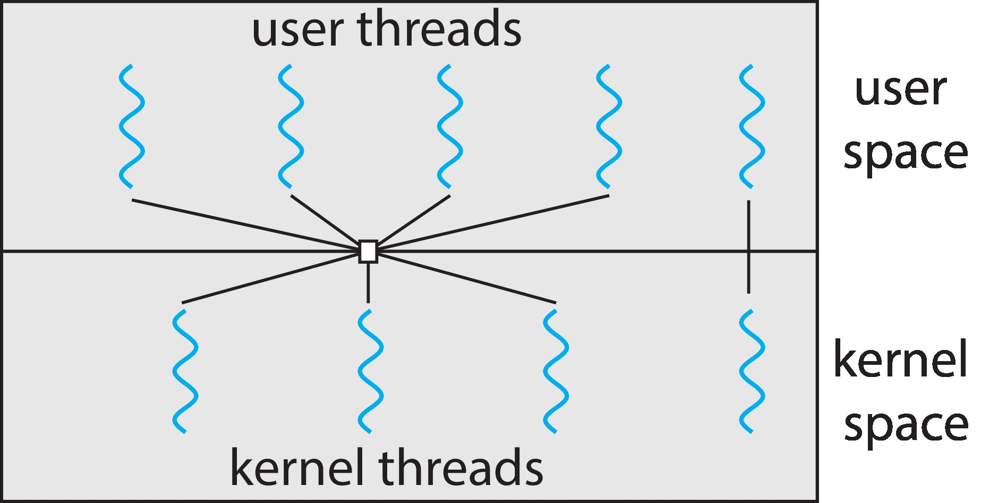
Two-level Model
Similar to M:M, except that it allows a user thread to be bound to kernel thread

Slide 11
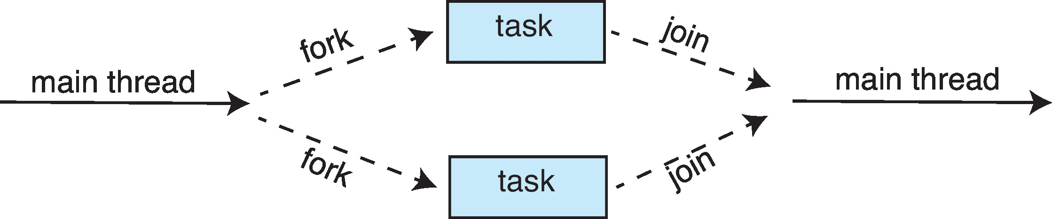
Fork-Join Parallelism
Multiple threads (tasks) are forked, and then joined.

